Slide 1

How to Use this Slide Deck
[Last Updated 08.20.2015]
What’s Included?
Instructional and exercise slides for the LabVIEW Student Ambassadors
End of lesson quiz questions
Exercises that are designated “Homework” exercises
What’s Excluded?
Sections involving hardware

Slide 3
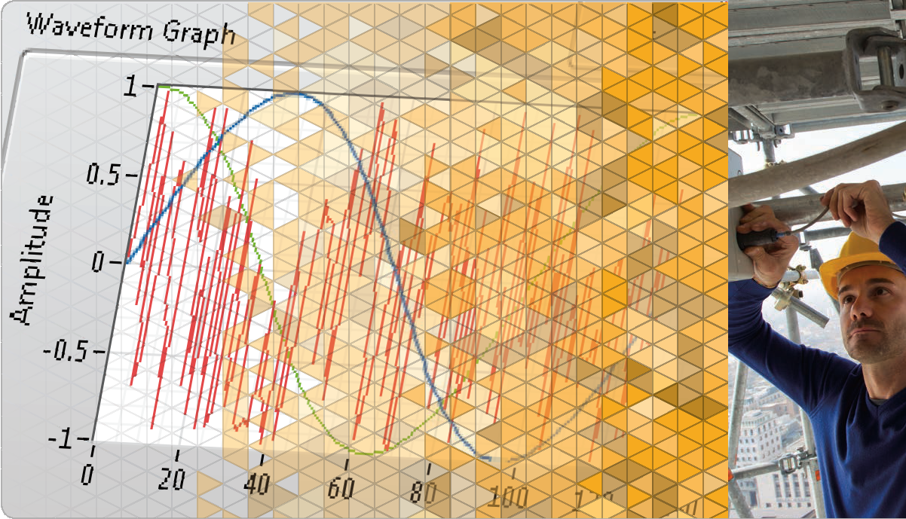
LabVIEW Core 1
Notes:
The slides from here to the first lesson slide are the standard front matter for any course. Any text in red should be replaced with text appropriate to your course.

Slide 4
Welcome to LabVIEW Core 1
Course Learning Map
Lesson 1
Troubleshooting and Debugging VIs
Lesson 4
Lesson 2
Navigating LabVIEW
Creating Your First Application
Lesson 3
Using Loops
Lesson 5
Modularity
Lesson 6
Creating and Leveraging Data Structures
Using Decision-Making Structures
Lesson 7
Lesson 8
Using Sequential and State Machine Programming
Lesson 9
Acquiring Measurements with Hardware
Accessing Files in LabVIEW
Lesson 10
Notes:
<Replace text with your lesson titles. Click each smart art, press the left expand icon, and add or remove Lessons as needed. Resize the smart art to fit the actual number of lessons.>

Slide 5
Lesson 6
Using Decision-Making Structures
Learn to create different decision-making structures and be able to identify applications where using these structures can be beneficial.
Case Structures
Event-Driven Programming

Slide 6
B. Event-Driven Programming
Recognize basic features and functionality of event structures.
Event-Driven Scenario
Polling Versus Events
Event-Driven Programming
Configuring the Event Structure
Caveats and Recommendations

Slide 7
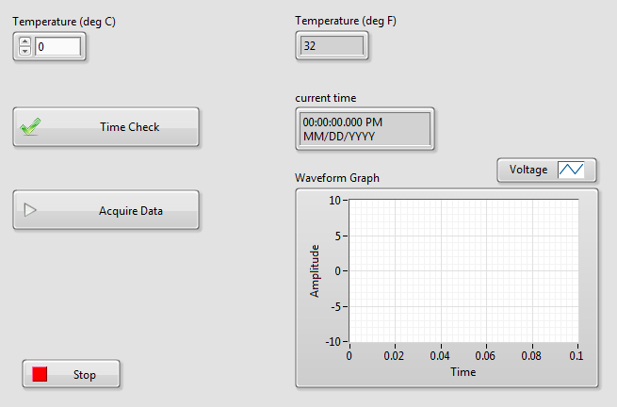
Event-Driven Scenario
Notes:
Refer to Instructor Guide for demo instructions.

Slide 8
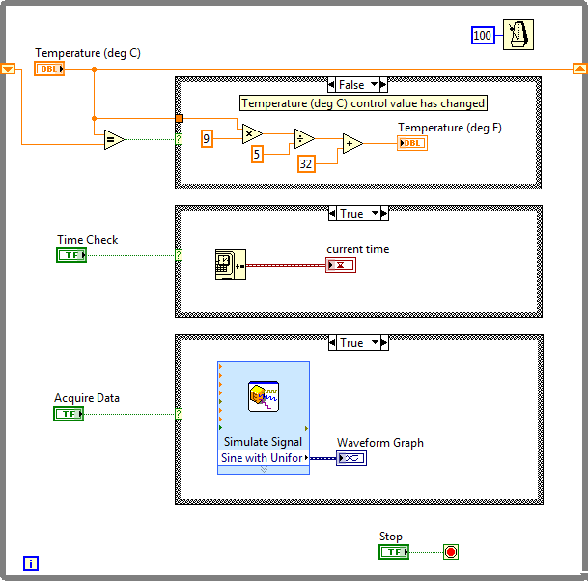
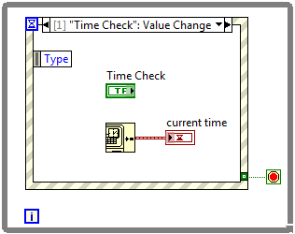
B. Event-Driven Programming
Polling Versus Events
Polling
Events
Notes:
Polling
Method of event-based programming where a loop must continually run code to check if changes have occurred.
Polling the front panel requires a significant amount of CPU time.
Polling can fail to detect changes if they occur too quickly.
Event Structures
Events in Event structures eliminate the need to poll the front panel.
Benefits of using Event structures:
Reduces the CPU requirements of the program.
Simplifies the block diagram code.
Guarantees that the block diagram can respond to all interactions the user makes. Handles all events in the order they occur. Does not miss any events.
Event-driven programs usually include a loop that waits for an event to occur, executes code to respond to the event, and reiterates to wait for the next event.
Events allow you to execute a specific event-handling case each time a user performs a specific action. Without events, the block diagram must poll the state of front panel objects in a loop, checking to see if any change has occurred. Polling the front panel requires a significant amount of CPU time and can fail to detect changes if they occur too quickly. By using events to respond to specific user actions, you eliminate the need to poll the front panel to determine which actions the user performed. Instead, LabVIEW actively notifies the block diagram each time an interaction you specified occurs. Using events reduces CPU requirements of the program, simplifies the block diagram code, and guarantees that the block diagram can respond to all interactions the user makes.

Slide 9
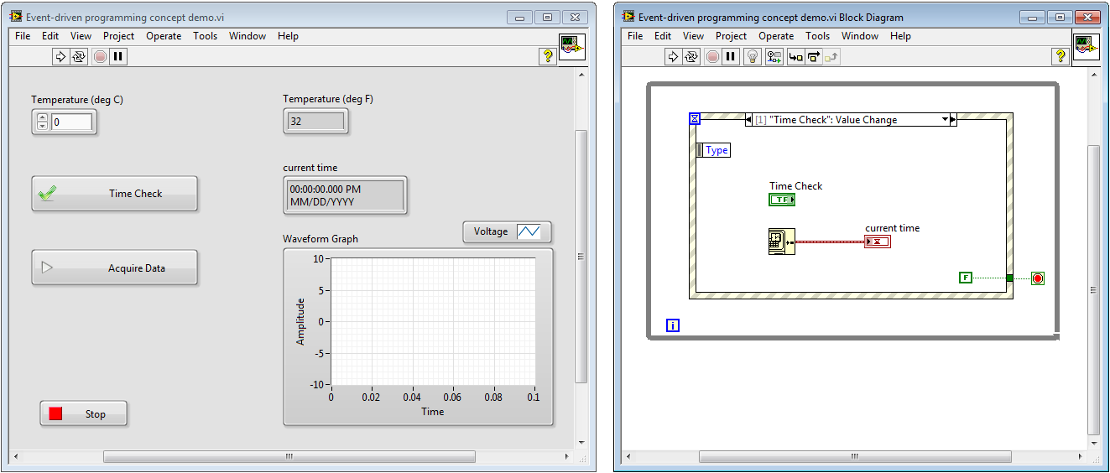
Event-Driven Programming

Slide 10
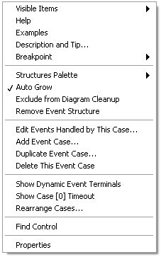
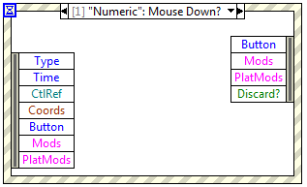
B. Event-Driven Programming
Configuring the Event Structure
Notes:
Event Structure Configuration
You can select exactly which events will wake up your Event structure by right-clicking the border and selecting Edit Events Handled by This Case from the shortcut menu. This opens the Edit Events dialog box.

Slide 11
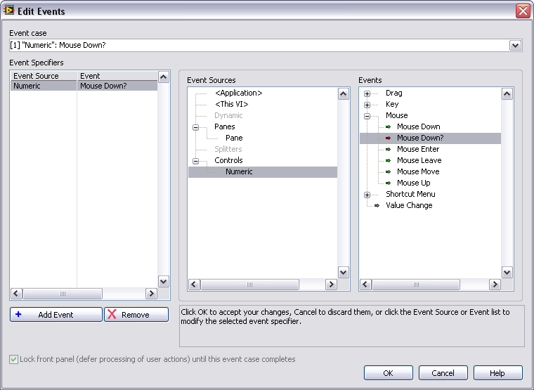
B. Event-Driven Programming
Edit Events Dialog Box
Configured Events
Events
Event Sources
Notes:
The dialog box is divided into 3 panes.
Configured Events: The left-most pane shows the list of specific events the current event case (sub-diagram) is configured to handle, displayed as pairs of <event source, event type>.
Event Sources: The middle pane shows the event sources (classes) you can choose from, which include the Application, the current VI, all of the controls on the VI’s front panel, and dynamic events.
Events: The right-most pane shows the individual events that the currently selected source on the left can generate. Clicking on an item in the event source or event type lists immediately updates the highlighted entry under Event Specifiers.
Notice that mouse and key events can be generated by either the VI or a control. You can set up the event structure to pay attention to both. LabVIEW delivers the VI event first, generated for mouse or key activity anywhere on the front panel, and then the control event if the mouse was in a particular control or the control had keyboard focus.
You can configure a single diagram to handle more than one event. To do this, click the Add Event button to add a new entry in Event Specifiers, and then use the Event Sources and Events panes to select its source and type. To share an event case, events should have compatible event data. Only data which is common to all events handled by an event case will be available in its event data node on the left border of the structure.
An event with a green arrow is a notify event; an event with a red arrow is a filter event.

Slide 12
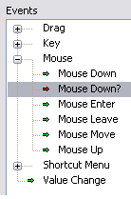
B. Event-Driven Programming
Notify and Filter Events
Notify Events
(green arrow)
Filter Events (red arrow)

Slide 13
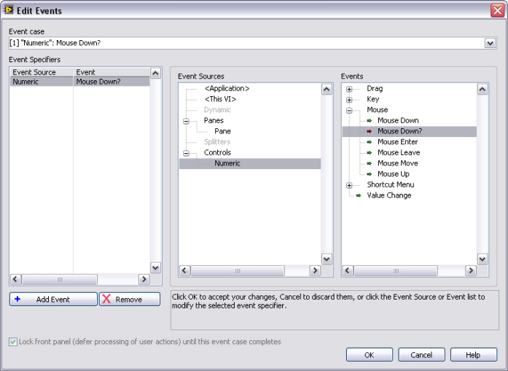
Configure and Use Events
Demonstrate configuring and using an Event structure.
Notes:
For the demonstration: Drop one or two controls on front panel, including a Stop button. On the block diagram, drop an Event structure in a While Loop. Configure the Event structure to respond to the front panel controls and then terminate using the Stop value change.
Describe the event registration as part of the demonstration.
Event Registration:
Collection of steps that happen behind the scenes to prepare the LabVIEW Event Handler to handle the event.
Event registration involves:
Allocation of memory to queue up events.
Spawning of pieces of code that run behind the scenes to catch events that happen. These pieces of code are called listeners or observers.
Key points:
LabVIEW registers events that you configure with the Edit Events dialog box.
When a registered event occurs, LabVIEW queues the event until the Event Handler executes.
It is not possible to miss events or process them out of order.
Events are unregistered when the VI becomes idle.

Slide 14
Exercise 6-2
Converting a Polling Design to an Event Structure Design
Convert a polling-based application to an Event structure-based application

Slide 15
Exercise 6-2
Converting a Polling Design to an Event Structure Design
How many times did the loop run with polling?
How many times did the loop run when you changed the VI to use an Event structure?

Slide 16
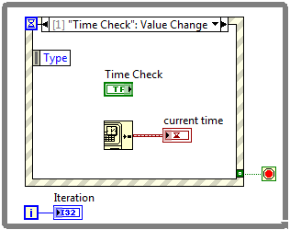
B. Event-Driven Programming
Caveats and Recommendations
Place only one Event structure in a loop.
Use a Value Change event to detect value changes.
Keep event handling code short and quick.
Place Boolean control terminals inside an event case for latched operations to work properly.
Avoid using an Event structure outside of a loop.
Avoid configuring two Event structures for the same event.
Notes:
For a complete list of Caveats and Recommendations, refer to LabVIEW Help topic: Caveats and Recommendations when Using Events in LabVIEW.
Avoid using an Event structure outside of a loop.
The Event structure handles only one event each time it executes.
Place only one Event structure in a loop.
If you place two Event structures in a single loop, the loop cannot iterate until both Event structures handle an event.
The loop can become unresponsive if two Event structures are in a single loop.
Avoid configuring two Event structures to handle the same event.
Use a Value Change event to detect value changes.
Value Change events will generate events regardless of how the user modifies the control.
Examples of Value Change events are: Keyboard shortcut, increment/decrement arrow buttons, keyboard entry in digital display
The Value Change event is easier and more efficient than attempting to monitor keyboard and mouse actions for a given control.
Keep event handling code short and quick.
It is possible to lock the user interface if code takes too long to execute.
For the UI Event Handler to be effective, the event handling code for all events needs to be short and quick!
When you trigger an event on a Boolean control configured with a latching mechanical action, the Boolean control does not reset to its default value until the block diagram reads the terminal on the Boolean control. You must read the terminal inside the event case for the mechanical action to work correctly.

Slide 17

B. Event-Driven Programming
Think about the VIs that you will need to develop at your job.
Will you use event-based programming to implement any of your VIs?
Why or why not?

Slide 18

Activity 6-2
Lesson Review
Refer to the participant guide to answer questions about what you have learned in this lesson and then discuss the answers as a group.

Slide 19
Lesson Review
Which of the following can NOT be used as the case selector input to a Case structure?
Error cluster
Array
Enum
String

Slide 20
Lesson Review
Which of the following can NOT be used as the case selector input to a Case structure?
Error cluster
Array
Enum
String

Slide 21
Lesson Review
How many events can an Event structure handle each time it executes?
As many as have occurred since the last time the event structure executed
One per configured event case
One

Slide 22
Lesson Review
How many events can an Event structure handle each time it executes?
As many as have occurred since the last time the event structure executed
One per configured event case
One

Slide 23
Lesson Review
Which statements about event-driven programming versus polling are true?
Events execute on demand.
Event-driven programming is less CPU-intensive.
Event structures handle all events in the order the occur.
Polling may fail to detect a change.

Slide 24
Lesson Review
Which statements about event-driven programming versus polling are true?
Events execute on demand.
Event-driven programming is less CPU-intensive.
Event structures handle all events in the order the occur.
Polling may fail to detect a change.

Slide 25
Lesson 7 Modularity
Recognize the benefits of reusing code and create a subVI with a properly configured connector pane, meaningful icon, documentation, and error handling.
Understanding Modularity
Icon
Connector Pane
Documentation
Using SubVIs

Slide 26
A. Understanding Modularity
Recognize the benefit of using modular code and identify sections of code that could be reused.
Modularity
SubVIs

Slide 27

A. Understanding Modularity
Modularity and SubVIs
Modularity — The degree to which a program is composed of discrete modules such that a change to one module has minimal impact on other modules.
SubVI—A VI used within another VI.

Slide 28
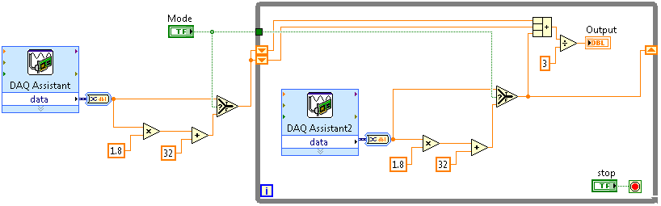
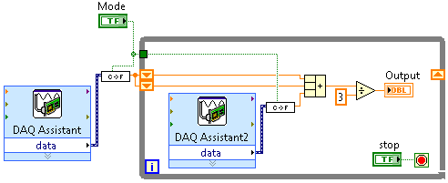
B. Understanding Modularity
SubVIs—Reusing Code

Slide 29



B. Understanding Modularity
SubVIs
Function Code | Calling Program Code
function average (in1, in2, out) { out = (in1 + in2)/2.0; } | main { average (point1, point2, pointavg) }
SubVI Block Diagram | Calling VI Block Diagram
Notes:
Every VI displays an icon in the upper-right corner of the front panel and block diagram windows.
The icon is a graphical representation of a VI and identifies the subVI on the block diagram of the calling VI.
The icon and connector pane correspond to the function prototype in text-based programming languages.

Slide 30
B. Icon
Recognize characteristics of a good icon and use the LabVIEW Icon Editor to create a custom icon.
Characteristics of a Good Icon
Using the Icon Editor

Slide 31
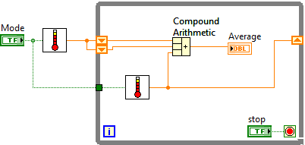

B. Icon
Purpose of Icon
Graphical representation of a VI
Identifies the subVI on the block diagram of the VI

Slide 32
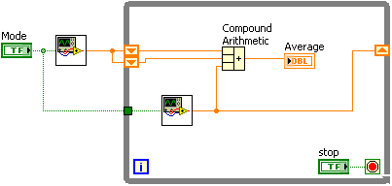
B. Icon
Characteristics of a Good Icon
Good icons convey the functionality of the VI.

Slide 33
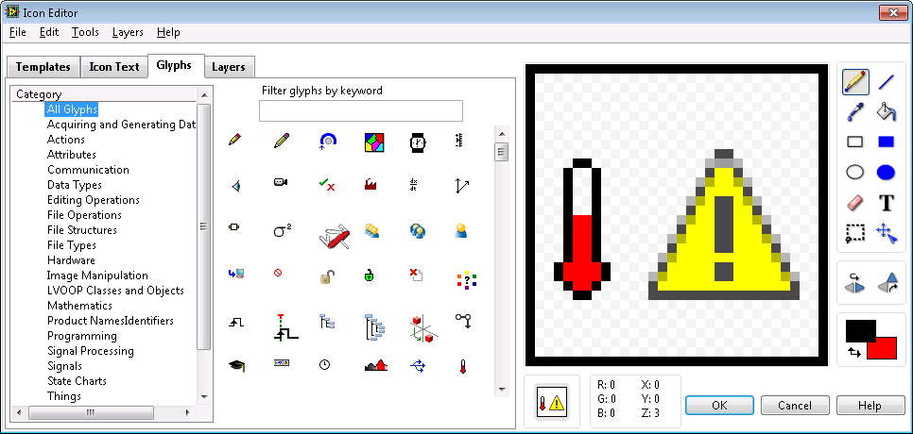
B. Icons
Creating Icons—Icon Editor
Notes:
After you build a VI, customize the icon so you can identify the VI when you use it as a subVI on a block diagram.
Create icons using the Icon Editor dialog box. Alternatively, you can drag a graphic file, such as a .bmp or .jpg, from your file system to the icon in the upper-right corner of the VI.

Slide 34
Creating an Icon
Use the LabVIEW Icon Editor to create a custom icon.

Slide 35
C. Connector Pane
Select and configure a connector pane for a subVI.
Patterns
Standards

Slide 36
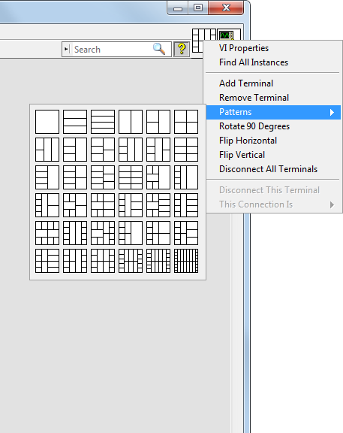
C. Connector Pane
Patterns
Displayed next to icon
Select from different patterns

Slide 37
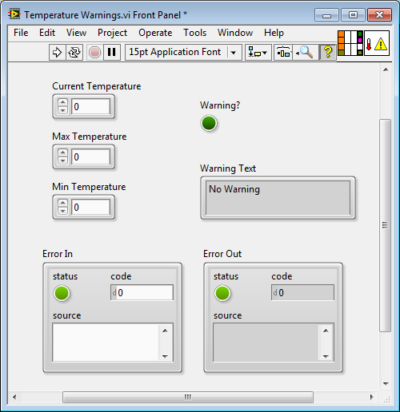

C. Connector Pane
Assigning Terminals
Current Temperature
Warning?
Max Temperature
Warning Text
Min.Temperature
Error In
Error Out

Slide 38

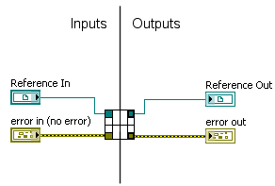
C. Connector Pane
Standards

Slide 39
D. Documentation
Explain how to document code in LabVIEW using descriptions and tip strips, and describe four methods for documenting code on the block diagram.
VI Descriptions and Tip Strips
Labels

Slide 40
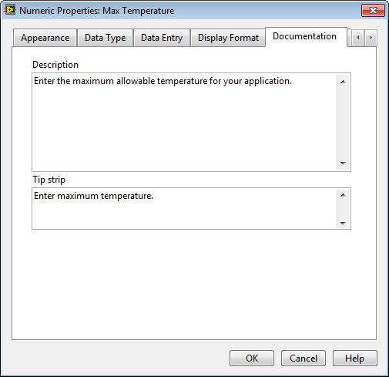
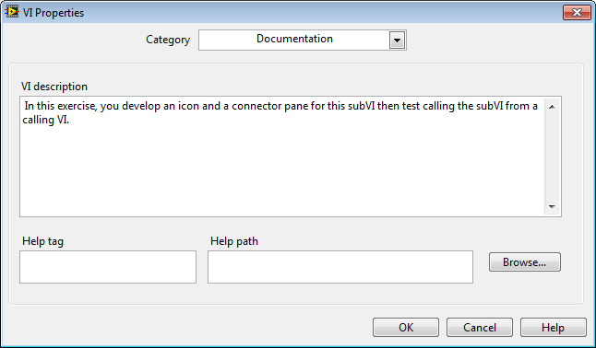
D. Documentation
Creating Descriptions and Tip Strips
Notes:
Instructor:
Demonstrate tips strips, descriptions and VI Properties, and how they appear in a VI. For example, VI descriptions show up in Context Help when you move the cursor over the object, and tip strips are brief descriptions that appear when you move the cursor over an object while a VI runs.
Create, edit, and view VI descriptions by selecting File»VI Properties and selecting Documentation from the Category pull-down menu. Create, edit, and view object descriptions by right-clicking the object and selecting Description and Tip from the shortcut menu. If you do not enter a tip in the Description and Tip dialog box, no tip strip appears.

Slide 41
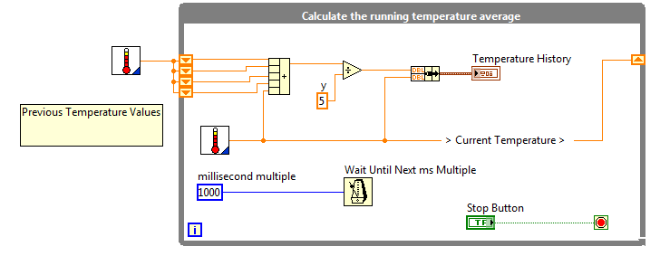
D. Documentation
Documenting Block Diagram Code
Free label
Owned label
Notes:
Use the following guidelines when commenting your VIs:
Use comments to document algorithms and add reference information.
Label structures to specify the main functionality.
Label long wires to identify their use/contents. (To label a wire, right-click on the wire and select Visible Items»Label.)
Label constants to specify the nature of the constant.
It is not always necessary to show labels on functions and subVIs if they make the block diagram cluttered. A developer can find information about a function or subVI by using the Context Help window.

Slide 42
E. Using SubVIs
Demonstrate how to place subVIs on the block diagram, explain terminal settings and error handling, and create subVIs from a section of existing code.
Placing SubVIs on the Block Diagram
Terminal Settings
Handling Errors
Creating from a Section of Block Diagram

Slide 43
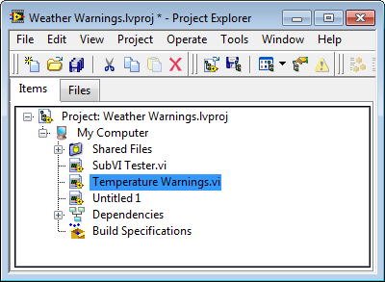
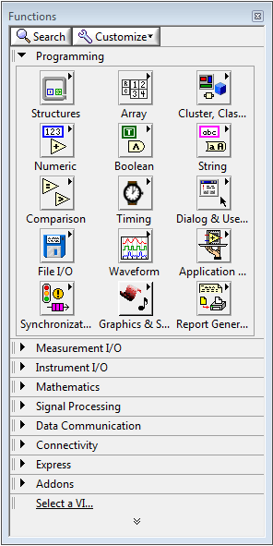
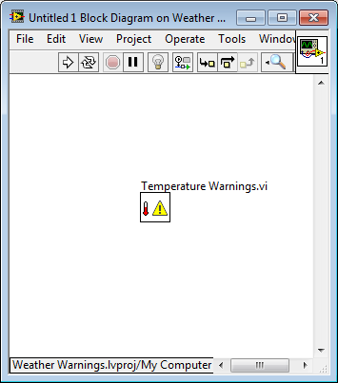
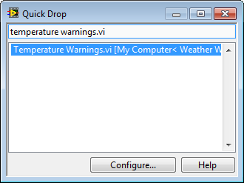
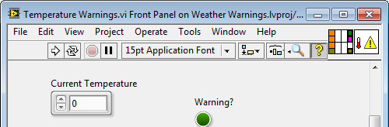
E. Using SubVIs
Placing SubVIs on the Block Diagram

Slide 44
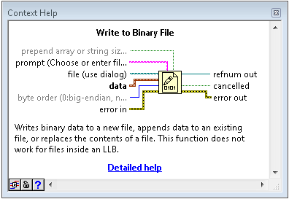
E. Using SubVIs
Terminal Settings
Bold
Required terminal
Plain
Recommended terminal
Dimmed
Optional terminal
Notes:
You can designate which inputs and outputs are required, recommended, and optional to prevent users from forgetting to wire subVI terminals.
Required means that the block diagram on which you place the subVI will be broken if you do not wire those inputs.
View the Context Help for the subVI to help identify the terminal settings.
To change a terminal requirement, do the following:
Right-click a terminal in the connector pane and select This Connection Is.
Select Required, Recommended, or Optional.
LabVIEW sets inputs and outputs of VIs you create to Recommended by default.
Set a terminal setting to required only if the VI must have the input or output to run properly.

Slide 45
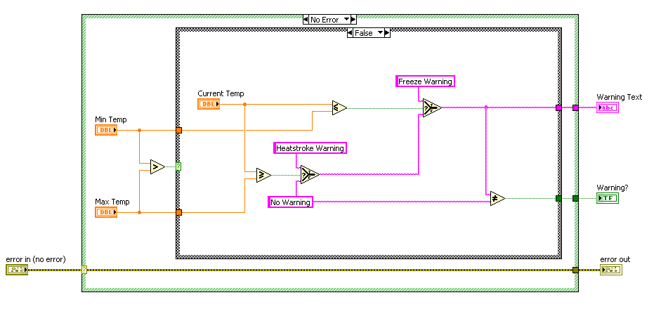
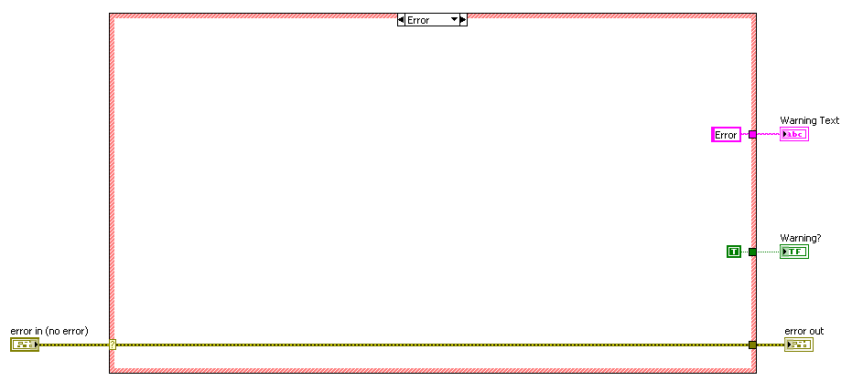
E. Using SubVIs
Handling Errors
Use a Case Structure to handle errors passed into the subVI.

Slide 46
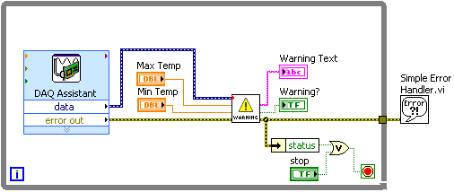
E. Using SubVIs
Handling Errors
Avoid using LabVIEW error handler VIs inside subVIs.

Slide 47
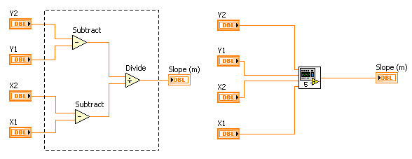
E. Using SubVIs
Convert a Section of a VI to SubVI
Select the section of the block diagram to reuse.
Select Edit»Create SubVI.

Slide 48
Exercise 7-1
Temperature Warnings VI – As SubVI
Create the icon and connector pane for a VI so you can use the VI as a subVI. Call the subVI from a test VI.

Slide 49
Exercise 7-1
Temperature Warnings VI – As SubVI
Do the terminal names in the calling VI need to match the subVI terminal names?
Do the data types in the calling VI need to match the subVI terminal data types?
Notes:
Do the terminal names in the calling VI need to match the subVI terminal names?
No. The names of wires and terminals used to pass data to subVIs do not need to match the subVI names.
Do the data types in the calling VI need to match the subVI terminal data types?
Yes. For example, a string cannot be wired directly to a numeric and vice versa. However, LabVIEW can coerce the numeric data type to the subVI data type (such as coercing an integer to a double), In addition, you can program the subVI to support polymorphic inputs.

Slide 50
Activity 7-1
Lesson Review
Refer to the participant guide to answer questions about what you have learned in this lesson and then discuss the answers as a group.

Slide 51
Lesson Review
On a subVI, which terminal setting causes a broken VI if the terminal is not wired?
Required
Recommended
Optional
Notes:
Answer is a.

Slide 52
Lesson Review
On a subVI, which terminal setting causes a broken VI if the terminal is not wired?
Required
Recommended
Optional
Notes:
Answer is a.

Slide 53
Lesson Review
You must create a custom icon to use a VI as a subVI.
True
False
Notes:
Answer is false. You do not need to create a custom icon to use a VI as a subVI, but it is highly recommended to increase the readability of your code.

Slide 54
Lesson Review
You must create a custom icon to use a VI as a subVI.
True
False
You do not need to create a custom icon to use a VI as a subVI, but it is highly recommended to increase the readability of your code.
Notes:
Answer is false. You do not need to create a custom icon to use a VI as a subVI, but it is highly recommended to increase the readability of your code.

